Slide 1
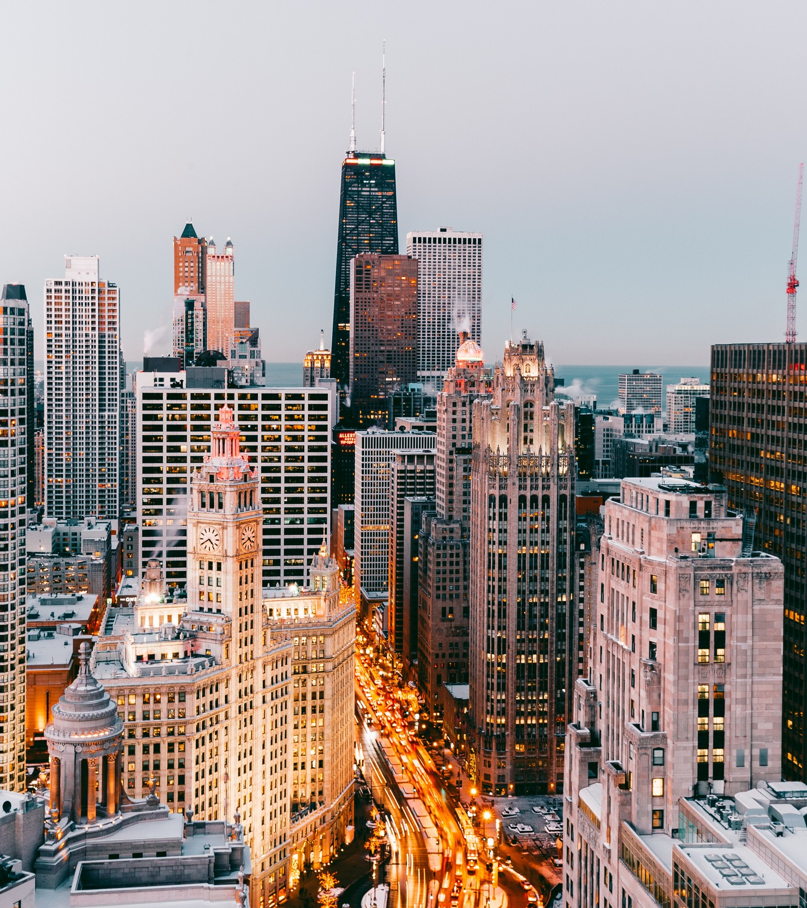
PROJECT FINAL REPORT
Digital image processing
--swe1010

Slide 2

PROJECT TILE
VEHICLE NUMBER PLATE DETECTION
--USING YOLOV5

Slide 3



Get to Know Our Team
Chandra Sekhar
20MIS1022
Lava Kumar
20MIS1090
Thanish Reddy
20MIS1057

Slide 4
Introduction
Number plate detection can be done by using deep learning-based state-of-the-art convolution neural network such as YOLO, SSD with resnet, Faster-RCNN, and many more. Each model has its own trade-off between speed and mAP. In this project, YOLOv5 is used which is based on the PyTorch library.

Slide 5

Literature servey
Author
title
software's
link
Gayatri Hajare1 Utkarsh Kharche2 Pritam Mahajan3 Apurva Shinde
Automatic Number Plate Recognition System for Indian Number Plates using Machine LearningTechniques
yolov5 using python
https://www.itm- conferences.org/articles/itmconf/pdf/2022/04/itm conf_icacc2022_03044.pdf
RAYUDU SUSHMA MADHURI RITHIKA DEVI , NIKHIL MAHESHWARAM
DR. SREEDHAR BHUKYA
Automatic License Plate Recognition with YOLOv5 and Easy-OCR method
https://www.ijirt.org/master/publis hedpaper/IJIRT155622_PAPER.pdf
YOLOv5
Easy-OCR method

Slide 6

Image Acquisition
methodology Algorithm
image will read from the data set using the path
The YOLOv5 Algorithm is used to locate different types of objects and to distinguish them. YOLOv5 is implemented using the Pytorch library mainly present in Python.
License Plate Detection

Slide 7
About the date set
we have taken data set from kaggle It contains 432 as input image, among those images we have trained 0.25 size of the images .

Slide 8
Requriments
Software
Hardware
python with opencv,tensorflow
,mathplotlib,pytorch etc
packages
laptop with 6gb ram
4gb graphic card
yolov5 google colab

Slide 9

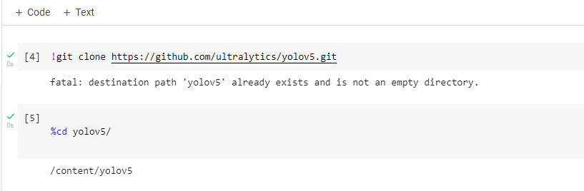
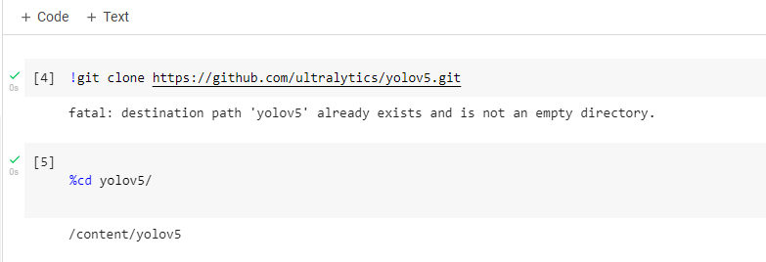

Experimental results
connecting with yolov5 clone through github in google colab

Slide 10

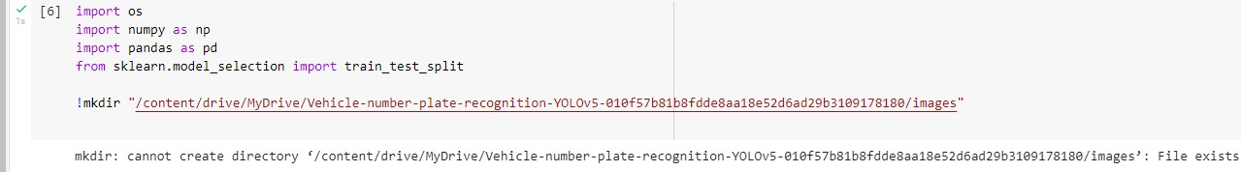


Slide 11

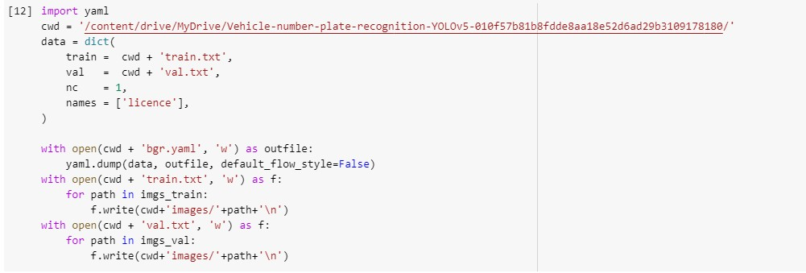

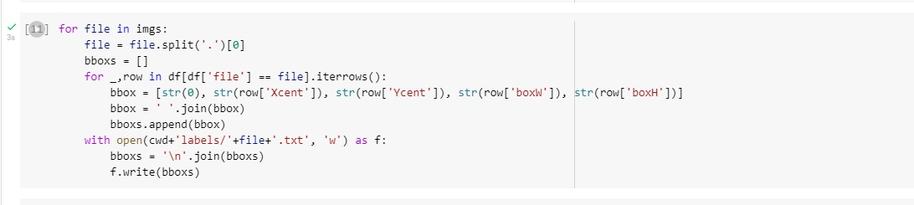

Slide 12

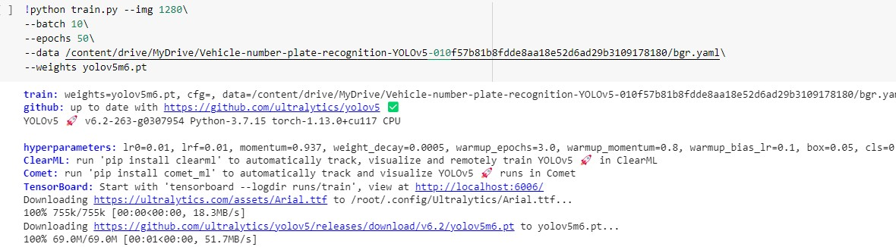


Slide 13

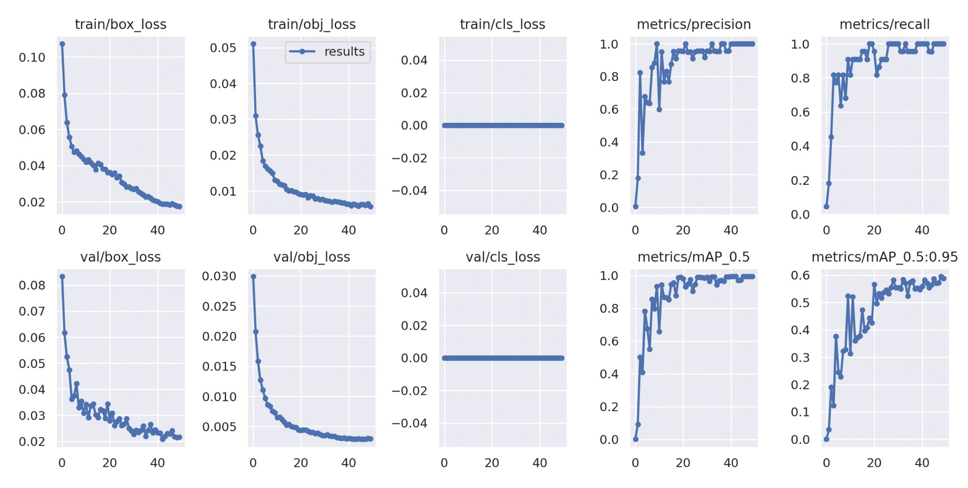


Slide 14
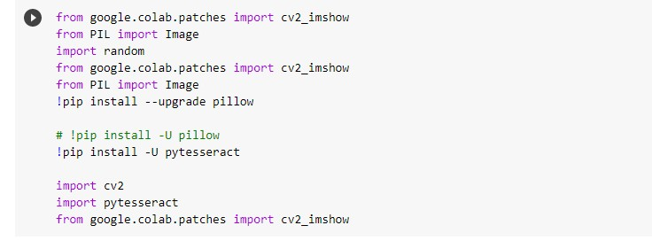
packages required for the ploting and detecting the number plate

Slide 15
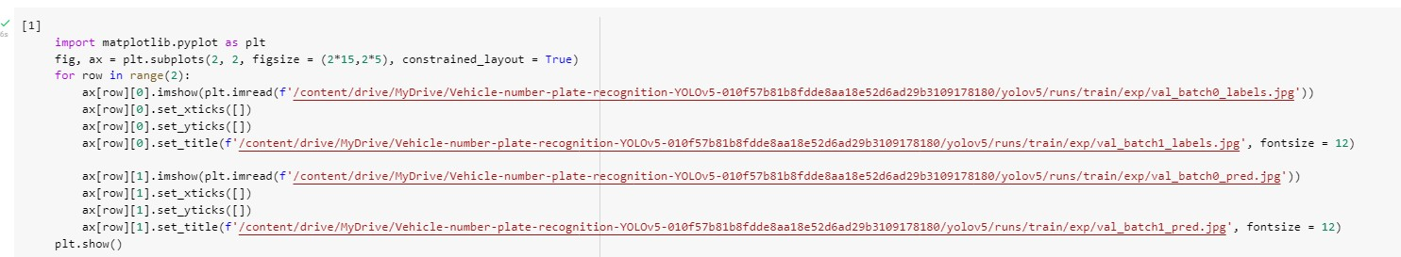
plot the result images

Slide 16
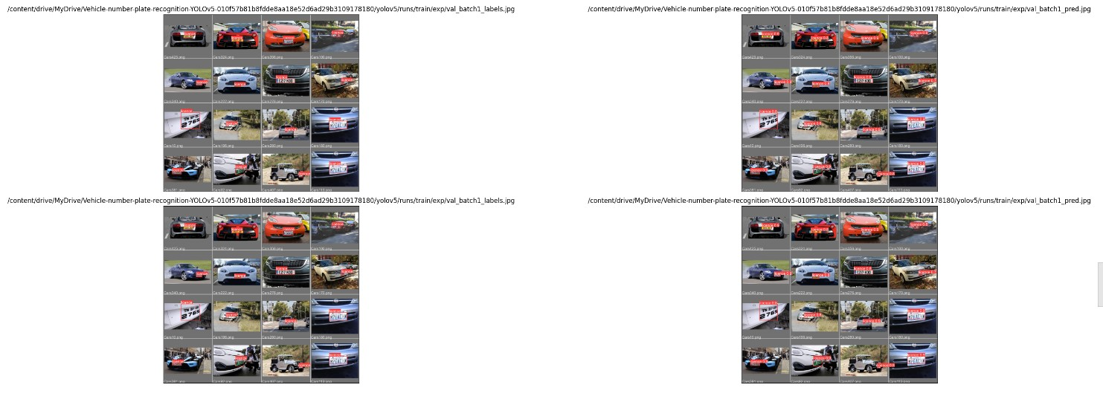
plot the result images

Slide 17
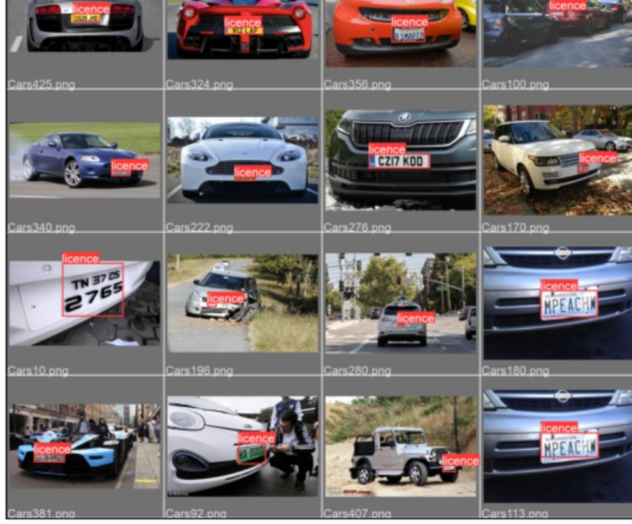
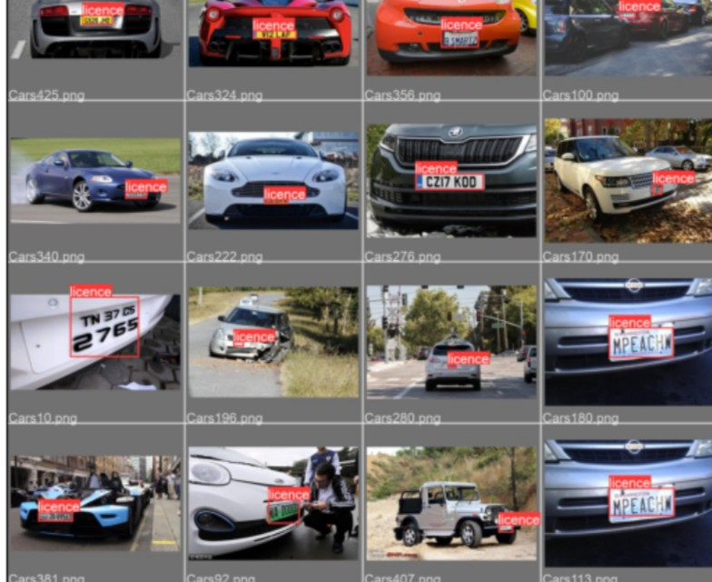

Slide 18
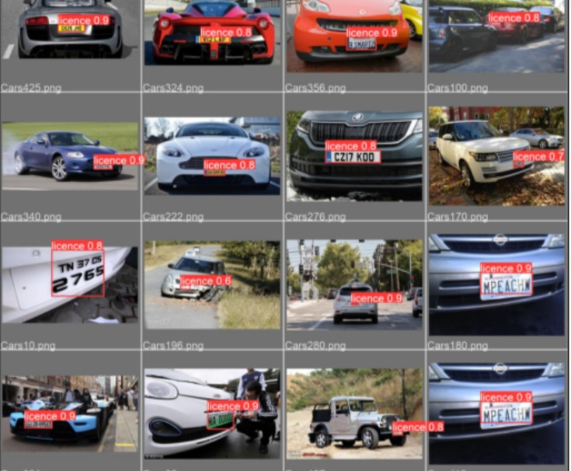

Slide 19
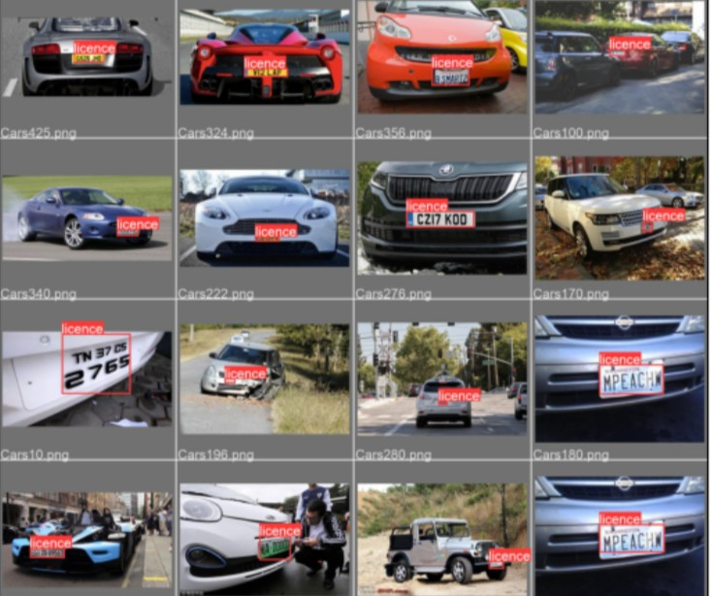

Slide 20
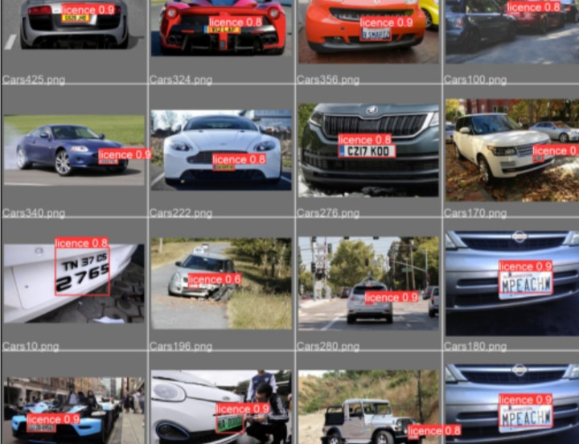

Slide 21
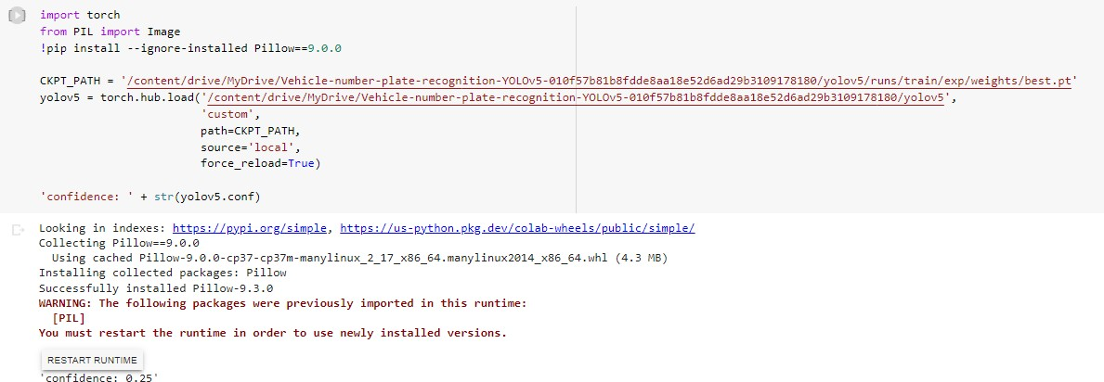

Slide 22
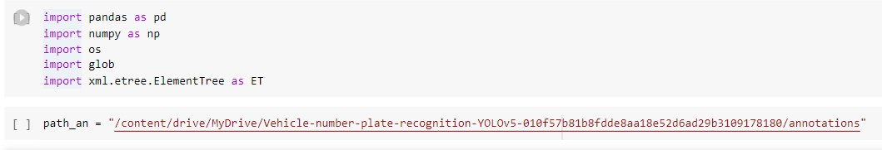
Car Plate Get Annotation Info from XML

Slide 23
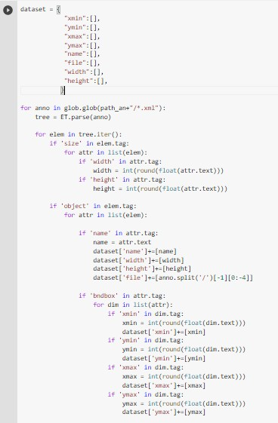

Slide 24
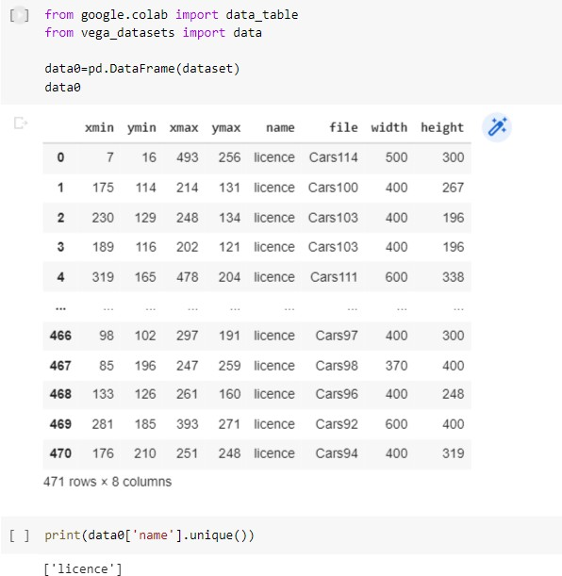

Slide 25
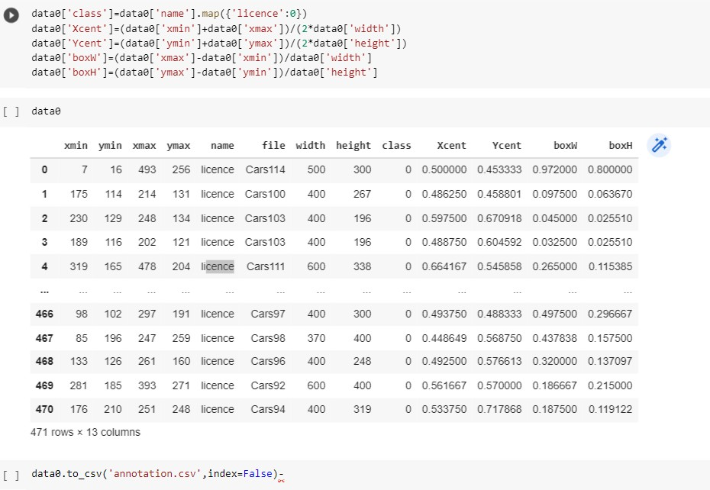

Slide 26



